Slide 1
Online Booking System
Group 8
Team Members:
108590037 徐妍婕 108820018 蔡翔宇
108AC1026 林 寧 110590057 蔡昀祐

Slide 2
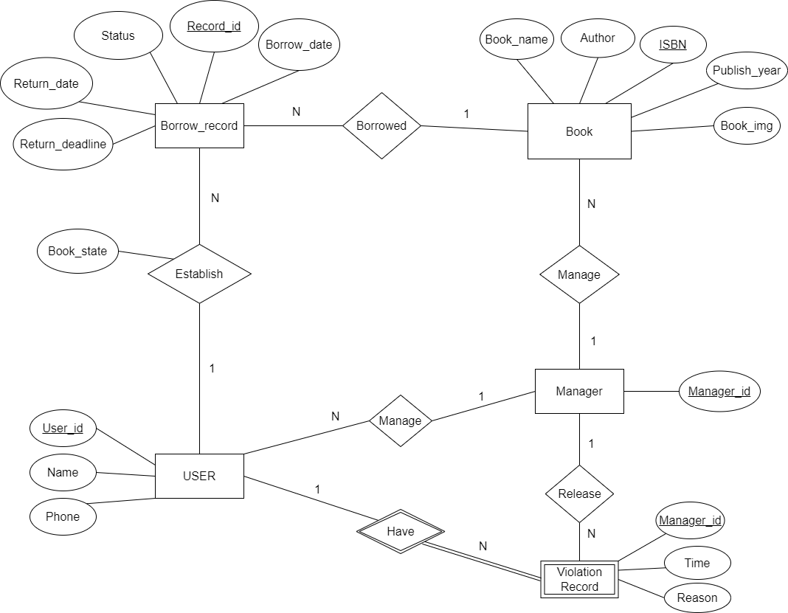
Diagram

Slide 3
catalog
Diagram
Page features
Demo

Slide 4
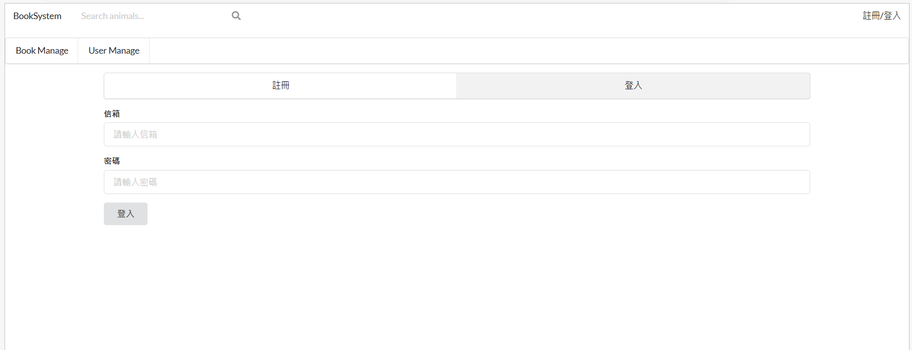
Log-in Page

Slide 5
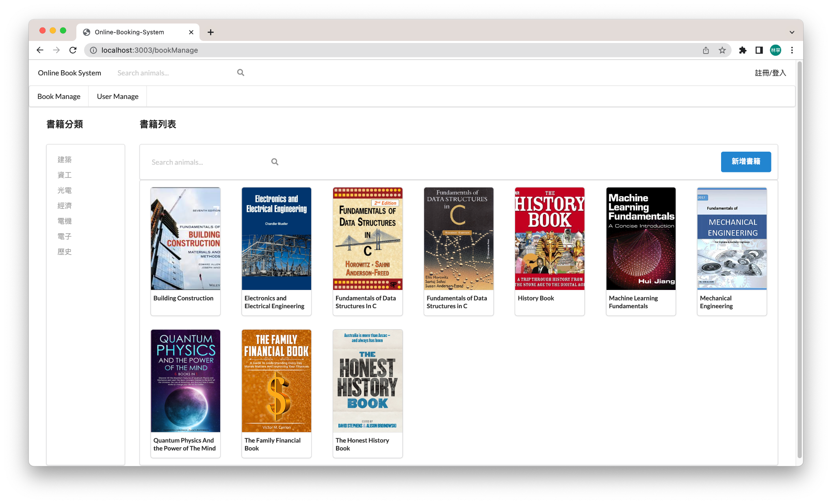
Book Manage Page

Slide 6
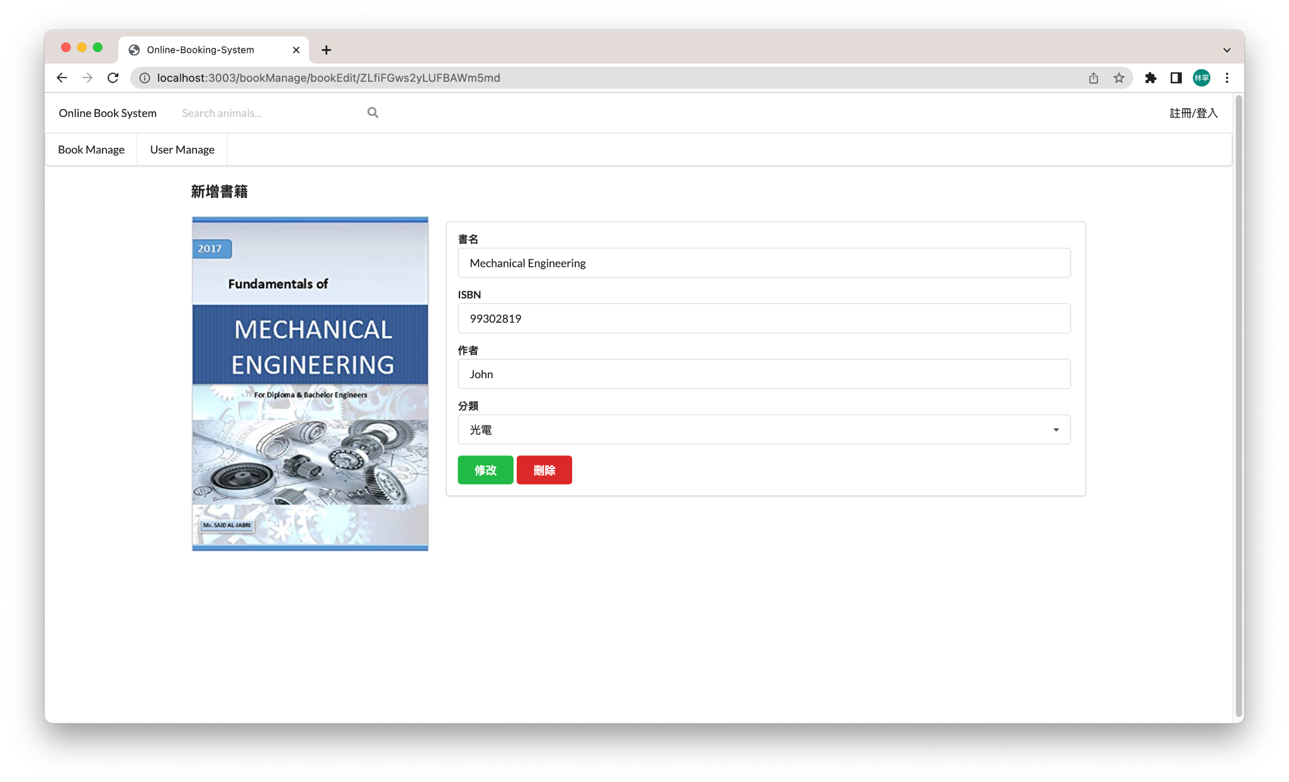
Book Edit Page

Slide 7
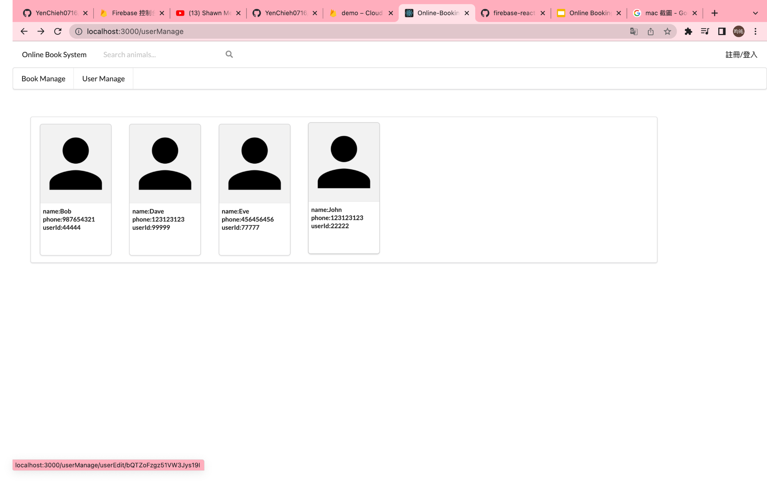
User Managing Page

Slide 8
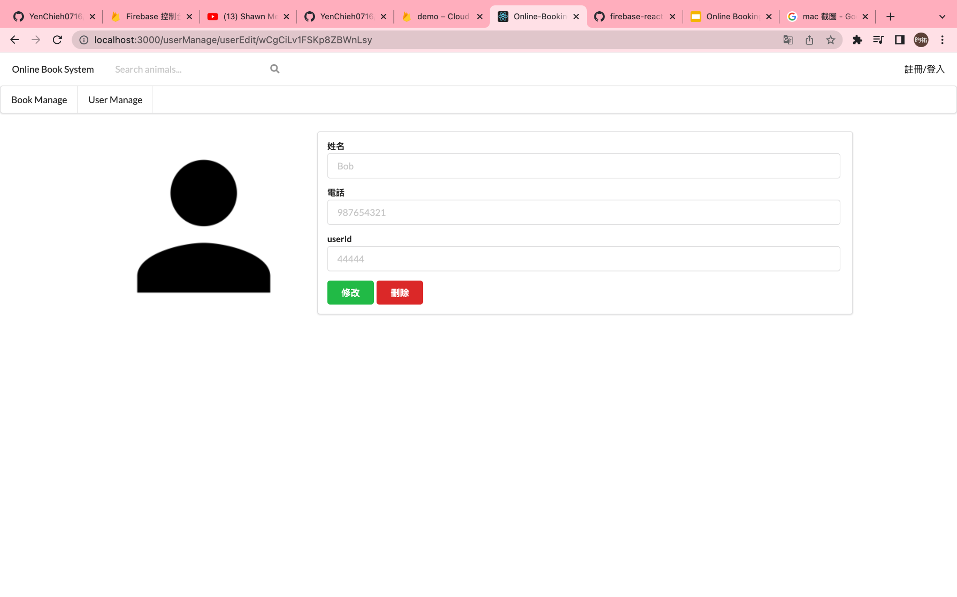
User Edit Page

Slide 9
Work assign
108590037 徐妍婕
Login page, Register page
108AC1026 林 寧
Book search page, Book edit page, Book manage page
108820018 蔡翔宇
Book cart, Book borrow page
110590057 蔡昀祐
User edit page, User manage page

Slide 10
Thank you
For listening

